Slide 1
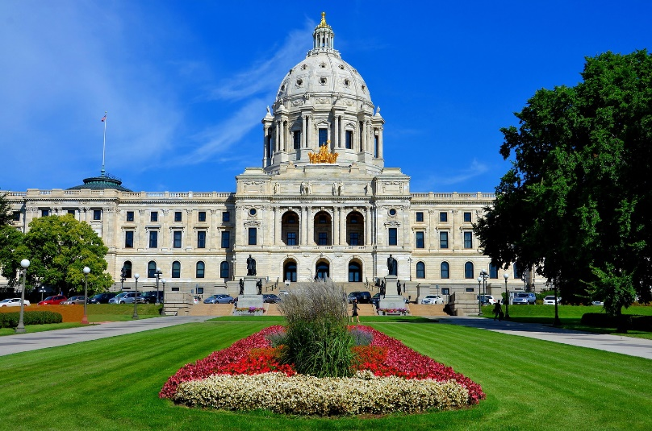
Legalization of Cannabis in Minnesota
Ken Winters, PhD
University of Minnesota & Oregon Research Institute (MN location)
Sheila Specker, MD
University of Minnesota

Slide 2
Ken C. Winters, Ph.D.
Trained as a Clinical Psychologist
Addiction researcher since 1987
Retired as Full Professor (Dept. of Psychiatry, University of Minnesota)
Now…
  Senior Scientist, Oregon Research Institute (MN location) (two ongoing, NIH-funded grants that focus on cannabis use and youth)
  Co-Founder and Research Advisor, Smart Approaches to Marijuana Minnesota (SAMMn)

Slide 3
Sheila Specker, MD, FASAM, DFAPA
Addiction Psychiatrist
Family Medicine
Program Director, Addiction Medicine Fellowship
Associate Professor, University of Minnesota
Committees:
  Minnesota Psychiatry Society: Program Committee Chair; legislative committee;
  MNSAM: advocacy committee

Slide 4
Smart Approaches to Marijuana Minnesota
(www.sammn.org)
Mission Statement
Our mission is to educate citizens and legislators about the current science regarding cannabis use and harms for the purpose of protecting the health and safety of Minnesotans.
Vision Statement
We envision a Minnesota where cannabis policies are aligned with the scientific understanding of its harms and benefits.

Slide 5
ASAM Position Statement on
Non-Medical Cannabis
Public health: Evidence-based prevention, no distribution <21
Decriminalize, expungement
Amend CSA
If legalize: use models other than commercialization (e.g., limit production, sale to nonprofits, public authority)

Slide 6
ASAM Position Statement on
Non-Medical Cannabis
If legalize: strong public health-based regulatory framework such as for alcohol, tobacco
  DOH as lead agency
  Restrict advertising
  Independent advisory board with strict COI
  Mandatory merchant education
  Local control
  Licensee liability
  Prohibition where tobacco is prohibited
  Prohibit additives
  Plain packaging
  Health warnings
  Quality standards

Slide 7
ASAM Position Statement on
Non-Medical Cannabis
Health messaging (MI, SUD, pregnant)
Limit potency
Tax revenue: prevention, mitigation, treatment, public awareness, enforcement

Slide 8
Personal View: The Many Influences on the Recent Legislative Process Regarding the Cannabis Bill
Political
Business
Medical Cannabis Program
Public Health

Slide 9
Public Health Influence
We engaged with legislators and the public in several ways: numerous 1:1 meetings; discussions with the bill’s authors; testified at most committee meetings; organized several public forums; and held a press conference
Personal view: political and business influences won out; several major public and safety health issues were not adequately addressed in the bill; disconcerting that many legislators expressed blatantly false or misleading statements in the context of minimizing health and safety consequences of further legalizing cannabis use

Slide 10
Examples of Statements by Legislators That I Saw as “Problematic”
“Cannabis is not addictive.”
“Driving high on cannabis is like driving after drinking cough syrup.”
“Cannabis is beneficial to a person’s mental health.”
“There is no evidence that prenatal exposure to cannabis is dangerous to the fetus.”
“Cannabis is relatively harmless.”
“Opioid fatal overdoses will be reduced if we legalize.”
“We need a legal market so my teen is protected from using weed with fentanyl in it.”
“Legalization will dry up the black market.”
“I don’t care what the science says. My constituents want legalization.”

Slide 11
Select Features of the MN Cannabis Legalization Bill
Adult possession, use and home cultivation of cannabis takes effect August 1.
  possess up to 2 ounces of cannabis flower, up to 8 grams of cannabis concentrates, and up to 800 milligrams of THC in edible cannabis products (~10 mg can get most people high)
  home possession: up to 2 pounds of cannabis (approx. 1,800 joints)
  home plants: 8 total plants, with no more than 4 flowering at any one time
Retail sales not likely until late 2024/early 2025.
  cannabis flower, concentrates, topicals and edible products, such as candy and beverages (but not with alcohol)
Decriminalization also begins August 1 (review and expungement of prior cannabis-related convictions).
Office of Cannabis Management: to license cannabis and hemp businesses and oversee the legal recreational market and the existing medical cannabis and hemp-derived markets.
  Medical Cannabis Program to be folded into this Office by 2025
Where to use? “strict limits on where consumption of cannabis products is allowed;” private residence ok; public use permitted if specifically allowed or licensed.

Slide 12
Select Features of the MN Cannabis Legalization Bill
Highway safety: $15 million allocated over the next two years to fund drug recognition training for law enforcement to help officers better identify impaired drivers.
Workplace safety: Except where required by federal law or for jobs in education, law enforcement, medical caregiving and other positions identified in the bill, applicants for jobs cannot be screened for marijuana as a condition for employment. Ongoing or random cannabis tests for many employees would also be banned.
Labeling/packaging: child-resistant; not to appeal to underage; “the maximum dose, quantity or consumption that may be considered medically safe within a 24-hour period”.
Sales of cannabis products would be taxed at 10%, with the state getting 80% and local governments getting 20%.
Prevention and treatment $$: establishment of a prevention, treatment and recovery grant program to be created with a “special revenue fund”.
Baseline study and U of MN Center for Cannabis Research
  Hennepin County to produce a "statewide baseline high intensity drug trafficking area report”
  funds allocated to School of Public Health for a Center on Cannabis Research

Slide 13

Main Health and Safety Features in the Bill (thumbs up, sort of)
Prevention programs aimed at both adolescents and young adults
Recognition that local control is important
Amount of allowed personal production and possession of cannabis products was reduced from the original amount
Membership of the Advisory Council to include some experts in addiction and behavioral health
Traffic safety issue received some attention
Start-up funds for a U of MN cannabis research center at School of Public Health
Baseline study on current health and safety issues

Slide 14
Main Health and Safety Features in the Bill (thumbs down)
No local opt out
Amount of allowed for personal production and possession unprecedented (approx. double to triple what other states allow)
Major guardrails to be determined by the Office of Cannabis Management
  ex: additional warning labels, THC limits, training requirements for workforce
Funds for prevention, treatment and recovery could be meager
Minimal funds for enforcement and monitoring of the upcoming retail business
Weak attention to the highway safety issue
No requirement for a yearly health and safety report
Advisory Council to the Office of Cannabis Management not well represented by health and medical experts

Slide 15
Among 51 Advisory Board members, only 9 (18%) have some health expertise
  nearly all either an existing commissioner or to be appointed by the governor
  no requirement for a physician
1. the commissioner of health or a designee
2. the commissioner of human services or a designee
3. an expert in pediatric medicine appointed by the governor
4. an expert in adult medicine appointed by the governor
5. an expert in prevention, treatment, and recovery related to substance use disorders appointed by the governor
6. one patient with experience in the mental health system or substance use disorder treatment system appointed by the governor
7. & 8. two licensed mental health professionals appointed by the governor
9. representative from the Local Public Health Association of Minnesota appointed by the association

Slide 16
Possible Action Steps
Apply for a position on the Advisory Board
Advocate for….
better health representation on the Advisory Board
more regular monitoring and trend reports of cannabis-related health and safety impacts; examples:
  % CUD in drug treatment programs
  % CUD among those receiving treatment for mental disorders
  % detected THC in suicide cases
  % detected THC in fatal motor vehicle accidents
  % detected THC in workplace accidents
more $$ to address the upcoming strain on drug treatment and MH services
required training of retail staff, supervisors and owners regarding the health and safety effects of cannabis
stronger health warnings on cannabis products

Slide 17
More Details on the Recent Law
Public Health Law Center’s Marijuana Landscape in Minnesota
  publichealthlawcenter@mitchellhamline.edu
MN Dept. of Health’s Cannabis Policy Overview
  Chris.Tholkes@state.mn.us

Slide 18
Focus on Research Findings
Several major scientific reviews from experts that are based on hundreds of research studies conclude that THC is not a harmless drug, and is more harmful in some respects compared to legal substances (alcohol and nicotine)

Slide 19
Legalization Effecting Policy
Rand report 2015
For profit marketing influences policy
Danger: regulations becoming more industry friendly
Commercialization: Increased use with lower prices

Slide 20
Counterpoint: Children, Post-Legalization Canadian study 2021
Increased rates severe intoxication; edibles predicted ICU
AMS, respiratory

Slide 21
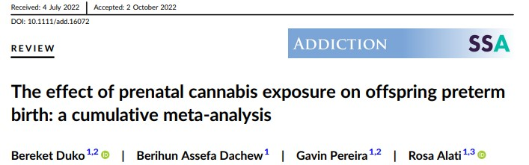
The Effect of Prenatal Cannabis Exposure on Offspring Preterm Birth: A Cumulative Meta-Analysis (Duko et al., 2022)
Total of 27 observational ( 304 to 4.83 million, published between 1986 and 2022)
Main findings (after controlling for other substance use):
  “Prenatal cannabis exposure was associated with a significant increased risk of preterm birth; 1.5 greater likelihood of a preterm birth when maternal use of cannabis occurred during pregnancy, compared when there was no maternal use during pregnancy.”
Canada (Luke 2022):
  Low BW
  SGA
  Preterm birth

Slide 22
Counterpoint: Post-Legalization- Adolescents
Early initiators: increased risk CUD
Early and continuous had most severe outcomes:
  persistent executive function
  psychiatric disorder
  several functional domains
  (25-year Great Smoky Mountains Study)

Slide 23
Long Term Use and Cognitive Reserves New Zealand longitudinal study 2022
1000 followed from birth – age 45
Those who began before 18
  IQ down 5.5 pts
  Smaller hippocampus volume
  Worse performance: learning, memory, info processing
Those who quit – did not show this

Slide 24
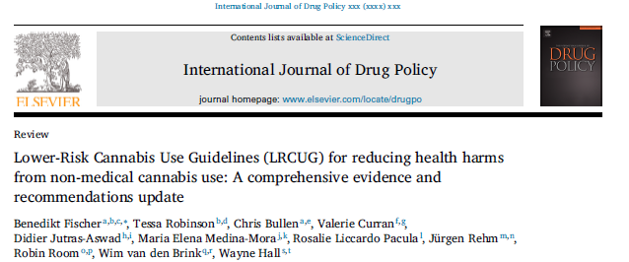
Lower-Risk Cannabis Use Guidelines (Fischer et al., 2021)
A Sampling of Precautions from the International Expert Panel
No universally safe level of cannabis use
Frequent cannabis use, and especially intensive use over longer periods, can lead to a ‘cannabis use disorder’ (CUD)
Evidence Grade: Substantial
Refrain from frequent (e.g., daily or near-daily) or intensive (e.g., binging) cannabis use
Evidence Grade: Substantial
Avoid driving a motor vehicle or operating machinery while under the influence of Evidence Grade: Substantial to Moderate

Slide 25
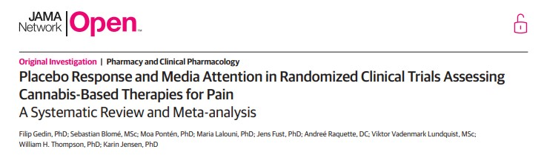
Placebo Response and Media Attention in Randomized Clinical Trials Assessing Cannabis-Based Therapies for Pain: A Systematic Review and Meta-Analysis (Gedin et al., 2022)
20 studies, 1,459 individuals
The main result: pain intensity was associated with a significant reduction in response to placebo, in the range of a moderate to large effect size.
Conclusion: “Placebo contributes significantly to pain reduction seen in cannabinoid clinical trials.”

Slide 26
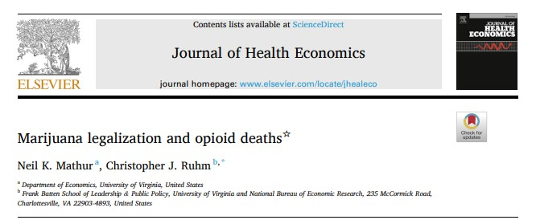
Marijuana Legalization and Opioid Deaths (Mathur & Ruhm, 2023)
National data from the U.S. Multiple Cause of Deaths database, spanning 1999-2019
Initial trend data: opioid deaths appear to reduce shortly after legalization policies are enacted by states, but the trend soon reverses and the “cannabis protection effect” is not observed
When the full ten year period was taken into account…
  recreational cannabis laws: 18% rise in opioid death rates
  medical cannabis laws: 28% rise in opioid death rates

Slide 27
Cannabis Use Disorder and Subsequent Risk of Psychotic and Nonpsychotic Unipolar Depression and Bipolar Disorder
Oskar Hougaard Jefsen, MD; Annette Erlangsen, PhD; Merete Nordentoft, DMSc; Carsten Hjorthøj, PhD
JAMA Psychiatry. doi:10.1001/jamapsychiatry.2023.1256
Published online May 24, 2023
Studied association with affective disorders
Prospective, population-based cohort study using Danish nationwide registers
6,651,765 individuals with or without cannabis use disorder
Increased risk of psychotic and nonpsychotic bipolar disorder and unipolar depression
Higher risk for psychotic bipolar than non-psychotic

Slide 28
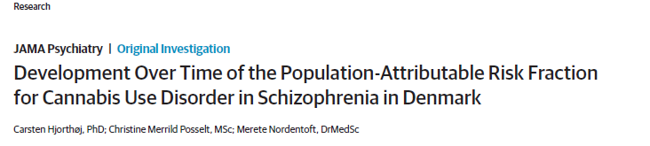
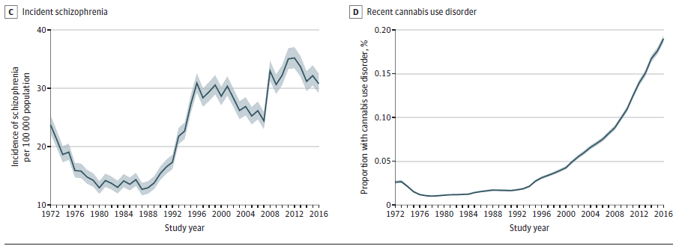
Danish National Study
new cases of schizophrenia
recent (within last 3 years) of cannabis use disorder
The health system in Denmark consists of nationwide, register-based historical health database of its citizens. They analyzed all people in Denmark who were (1) born before December 31, 2000, and (2) alive and 16 years or older at some point from January 1, 1972, to December 31, 2016.
This study charted those who developed a first-episode of schizophrenia and also charted those who were recently diagnosed with a cannabis use disorder.

Slide 29
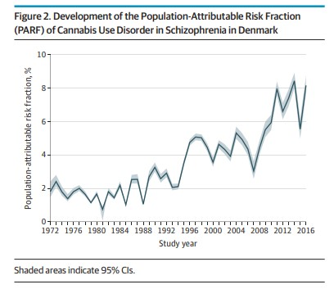
What Does the Danish Study
Tell Us?
From the authors: Our data show the proportion of cases of schizophrenia associated with cannabis use disorder has increased 3- to 4-fold during the past 2 decades, which is expected given previously described increases in the use and potency of cannabis.
Association of the incidence of schizophrenia and cannabis

Slide 30
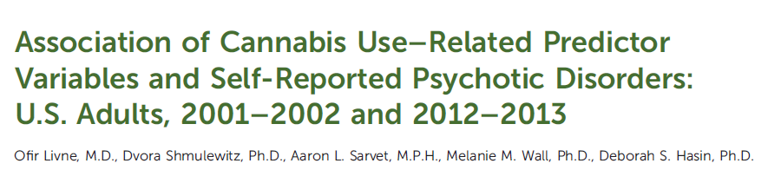
Association of Cannabis Use and Psychotic Disorders
First US study of general population collected between 2001-2002 and 2012-2103 compared self-reported psychotic disorder and cannabis use
Prevalence of past-year self-reported psychosis:
  increased significantly between 2001–2002 and 2012–2013
Association of self-reported psychosis and non-medical cannabis use:
  2001–2002: self-reported psychotic disorders were unrelated to use of nonmedical cannabis
  2012–2013: self-reported psychotic disorders were significantly more common with nonmedical cannabis use; largest association with daily users and those with a cannabis use disorder
  Potency effect

Slide 31

The Health Effects of Cannabis and Cannabinoids: The Current State of Evidence and Recommendations for Research (National Academies of Sciences, Engineering, and Medicine, 2017)
Composite list of those with substantial/moderate evidence:
increased risk of motor vehicle crashes
increased risk for lung cancer
lower birth weight of the offspring (maternal cannabis smoking)
cognitive impairments (acute effects)
development of schizophrenia or other psychoses; highest risk among heavy users of high potency products
development of problem cannabis use, particularly when onset of use occurs during adolescence

Slide 32






THANK YOU !
Contact: Ken C. Winters, Ph.D.
winte001@umn.edu
Sheila Specker, MD
speck001@umn.edu
Notes:
Comments, questions and time for discussion.

